Slide 1


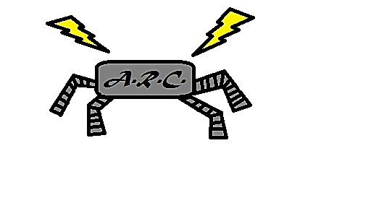

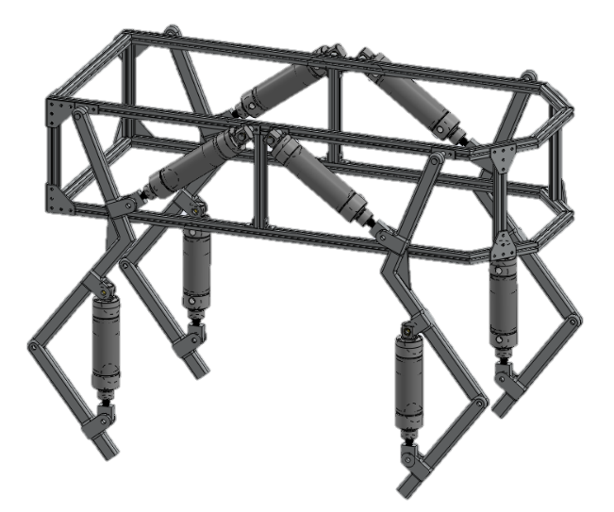
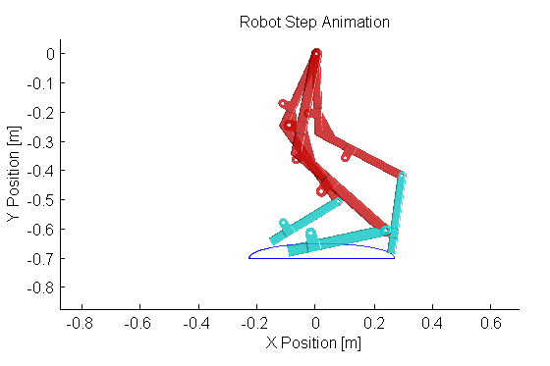
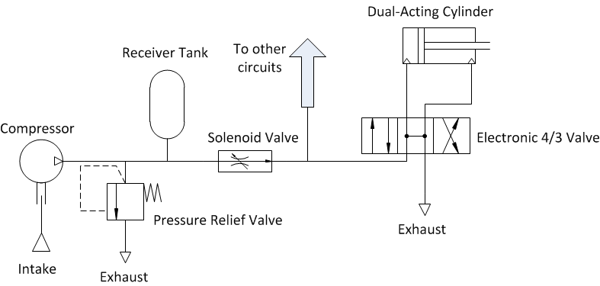
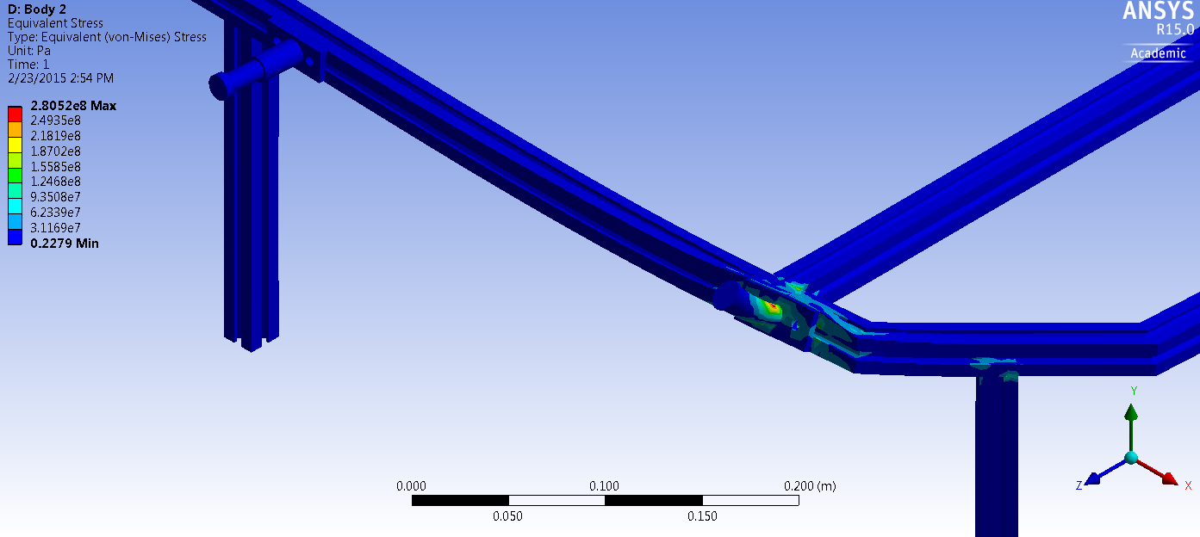

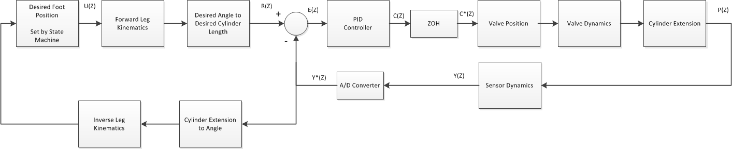
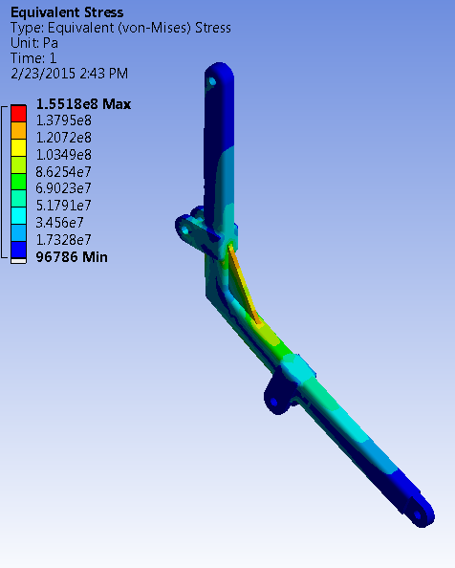
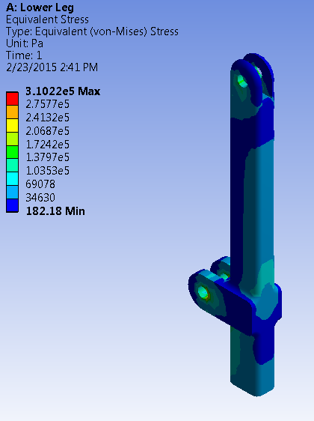
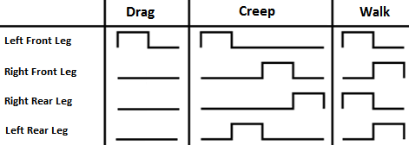
Development of an Agile Pneumatic Educational Robot
Team ARC: Logan Beaver, Justin Campbell, Tyler Paddock, and Ron Shipman
Milwaukee School of Engineering – Mechanical Engineering Department
Spring, 2015
Simulation
Problem Statement
To determine the forces and torques acting on the robot during motion a dynamic and kinematic simulation was developed. The kinematic simulation calculated the angular position, velocity, and acceleration of each joint as the foot moved through an elliptical trajectory. The dynamic simulation then took these values along with some assumed foot reaction forces and calculated the resulting torques and forces acting on each joint.
Recently there has been a decline in interest and proficiency related to science, technology, engineering, and mathematics (STEM) fields. According to a 2013 survey by Junior Achievement USA, 46% of US teenagers showed interest in pursuing a STEM or medical related career, which was a 15% decrease from previous years. In addition there is a huge deficit of fluid power engineers in the United States with only 1% of Universities with engineering programs teaching a fluid power concentration. It has also been shown by a study conducted at the University of Nebraska that introducing students to topics in robotics not only improves their attitude towards STEM topics, but also increase their self-efficacy of topics within robotics.
Objective
Leg Pneumatic Circuit
Figure 6: Image of the kinematic simulation
To address the existing challenges an educational robotics platform was developed to increase student interest in STEM fields, fluid power, and robotics through outreach opportunities, laboratory exercises, and research experiences.
Electrical Design
In order to actuate the robot’s legs a pneumatic circuit was developed which uses the following steps to extend a cylinder:
Air is compressed and stored in a receiver tank
A solenoid valve is opened to engage the eight pneumatic circuits
Air is passed through a 4 port/3 position solenoid valve to extend or retract a dual acting cylinder
Air is exhausted out of the other end of the 4/3 valve.
This process is repeated for each of the eight dual acting cylinders on the robot.
The Arduino Mega microcontroller outputs pulse-width modulated signals which are converted into analog signals using signal conditioning circuitry consisting of a low pass filter and a second-stage amplifier. The analog signal directly controls valve positions. Sensors inside the pneumatic cylinders are used as feedback to the control running on the Arduino microcontroller.
Design Criteria and Constraints
Mechanical
A maximum weight of 35 kg for portability
Maximum speed of 0.5 m/s
Maximum size of 0.75 m x 0.75 m x 1.0 m box for portability
Mechanical protection to reduce the risk of pinching and self-collision damage to the robot
MATLAB and Simulink model support to allow mechanical engineering students to update control algorithms without knowledge of C/C++
A pressure relief valve to reduce the risk of overloading and damaging pneumatic components
Electrical
Electronic fuses and shielding to protect the robot and operator during use and maintenance
Custom debug panel creation to facilitate troubleshooting
An easy to access emergency stop to quickly depower the robot
Arduino
Mega
Pulse Width Modulated Signal
Analog Signal
Valves and Cylinders
Low Pass Filter
Feedback Signal
Figure 7: Electrical Signal Path and Conditioning
Human Machine Interface
To control the motion of the robot the user sends a direction request to the Java Graphical User Interface (GUI), which encodes the request and wirelessly transmits it to the onboard Arduino microcontroller. The microcontroller responds to a user request by taking a step in the requested direction.
Sequence of Events in Sending a Command
User input is read by a USB controller
Real time Java application parses user input
Application sends commands through an XBee radio module
Partner XBee chip receives the command and sends it to the Arduino microcontroller
Arduino decodes the serial command executes an action accordingly
Mechanical Design
Figure 3: The pneumatic circuit diagram for a single cylinder. Eight of these work in parallel to move the robot’s four legs.
The chassis was constructed from 80/20 6105-T5 aluminum extrusions with a 6061 aluminum plate for component mounting. 80/20 aluminum was chosen for the chassis to simplify fabrication of the robot in addition to being lightweight and having a high yield strength. A worst case loading Finite Element (FE) analysis was done on the chassis. The analysis used reaction forces and load torques applied to the static structure at the shoulder joint.
Stability and Gait Development
In order to ensure dynamic stability for the robot the Zero Moment Point (ZMP) method was used. The zero moment point can be calculated from the reaction forces acting on each foot. The location where the torque induced by these reactions is zero is the ZMP. In low speed applications such as this one the ZMP can be approximated by the center of gravity (CG). As long as the CG falls within the convex polygon created by the robot’s contact points with the ground it is in a statically stable pose. When the CG passes outside of this polygon an unbalanced tipping moment is created and the robot becomes unstable.
Arduino Mega 2560
Convex Support Polygon
Tipping Moment
XBee
XBee
Figure 1: FE Analysis performed on the chassis in ANSYS. The simulation assumed a worst case static loading where the joints lock up completely during motion. The maximum stress was found to be 240 Mpa, which gives a factor of safety of 1.15 in this worst case scenario.
Center of Gravity
Figure 8: High Level Communication System Diagram
Control Architecture: Single Leg
The legs of the robot were machined from 6061 aluminum bar stock. Bar stock was chosen to increase the cross sectional area of the leg. The extra area made it easier to attach the cylinders to the leg while also reducing the risk of buckling. The bend in the upper shank was created by welding two segments of bar stock together, and was done to create more convenient cylinder attachment locations. A static finite element (FE) analysis was performed on the legs assuming load forces and torques applied at each joint. It was assumed that the leg joints seize in the worst case scenario, and each joint was grounded to prevent movement.
Mathworks Simulink model is loaded onto the Arduino
Utilizes PID feedback loops to control cylinder lengths
Desired length is calculated by a state machine based on user input and current length
Points of Contact
Figure 4: Top and side view of the robot model’s convex support polygon and an induced tipping moment. The tipping moment is caused by the center of gravity being outside of the convex support polygon.
The four gaits examined during the project were drag, creep, and walk. A diagram of leg actuations can be seen below for each gait:
Figure 9: Block diagram for a single leg controller. The left loop determines the desired cylinder legs based on the current foot position. The right loop is a PID controller for a single leg which moves the foot into position. For a full robot there are eight copies of the right loop.
Conclusion and Results
An educational pneumatic robot was developed that is capable of walking
The robot kinematics and kinetics were determined to aid in the mechanical design
The mechanical prototype was constructed for hardware testing
Electrical subsystems were soldered to prototyping boards for hardware testing
A wireless communication system and user interface was created
More work is needed to implement more dynamic gaits and to characterize the valve/piston system dynamics
Additional work is also needed to characterize the performance of the current controller and to implement a more sophisticated multivariable control architecture
Figure 2: The FE analysis performed on the thigh (left) and shank (right). A flange was added to the thigh to reduce the overall stress in the weld. A maximum stress of 155 Mpa was found in the leg, which results in a factor of safety of 1.74.
Figure 5: Three slow gait patterns for a four legged robot. The drag and creep gait involve moving a single leg, and are statically stable. The walk gait involves moving two legs at once, and is dynamically stable.
Acknowledgements
Special thanks to Joy Global, Inc., the National Fluid Power Association, Emerson, Otto J. Maha Endowment Fund, MSOE, Quinn McCartin, and Dr. Luis A. Rodriguez for their support

